Slide 1

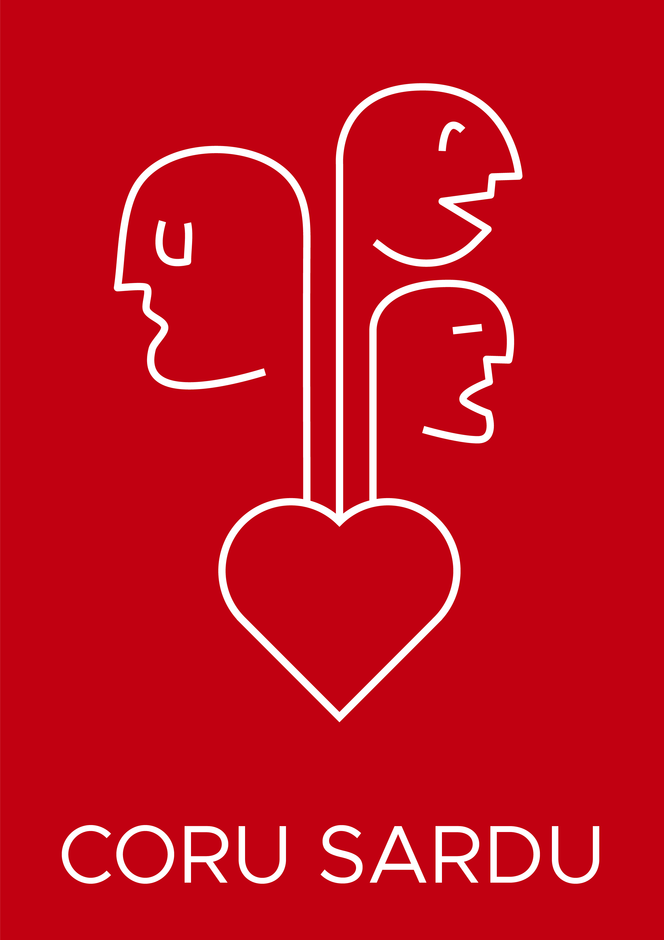


CORU SARDU

Slide 2
Ita cosa est Coru Sardu?
What is Coru Sardu?
Est unu servìtziu de lìngua sarda de sa Azienda Sanitària Locali de su Campidanu de Mesu, finantziau po mori de su Bandu TuLis, cun sa L. 482/1999 “Normas in matèria de amparu de is minorias linguìsticas stòricas ” e cun sa L.R. 22/2018 “Disciplina de sa Polìtica Linguìstica Regionali”, chi amparant, promovint e avalorant is lìnguas de minoria in Sardìnnia
It is a Sardinian language service of the Local Health Authority of Medio Campidano, funded through the TuLis call for projects, with Law 482/1999 on the protection of historical linguistic minorities and with Regional Law 22/2018 'Regulation of Regional Language Policy', which supports, promotes, and values minority languages in Sardinia

Slide 3
Comenti est nàsciu su progetu?
How did the project start?
Est nàsciu in su repartu de Cardiologia de s’ispidali Nosta Sennora de Bonària de Santu ‘Èngiu, ghiau de su primàriu Gianfranco Delogu, cun s’idea primàrgia
de acuntentai is abbisòngius de is malàdius chi lompint de totu is biddas de sa provìntzia e funt acostumaus a fueddai pruschetotu in sardu
It was created in the cardiology department of the Nostra Signora di Bonaria hospital of San Gavino Monreale, led by Dr. Gianfranco Delogu, with the initial idea of meeting the needs of patients coming from the villages of the province who habitually speak Sardinian

Slide 4
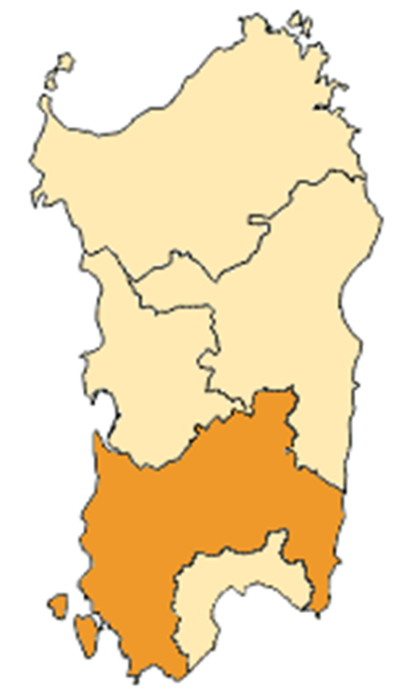
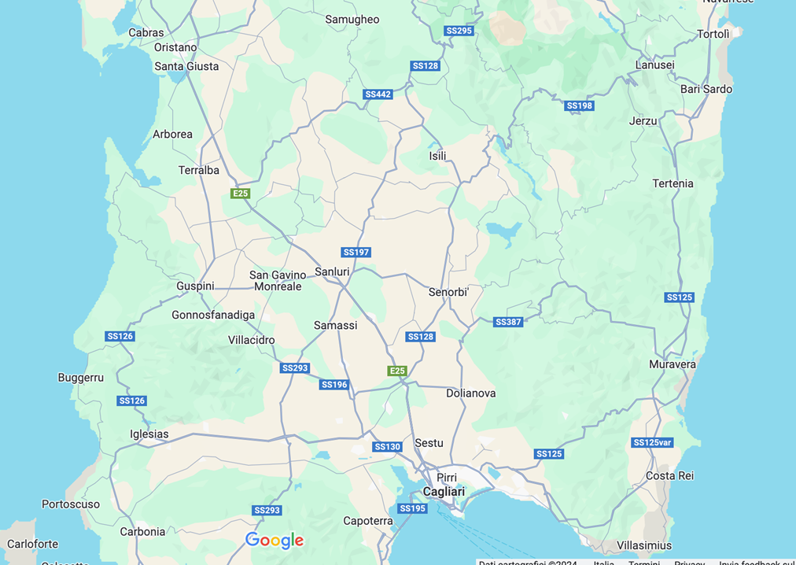

Slide 5
Sa tarea cali est?
What is the goal?
Su podi fueddai in sardu in calisisiat logu est unu deretu de is tzitadinus stabiliu de is Leis de amparu de is Lìnguas de minoria e duncas custu progetu punnat a assegurai s’arrispetu de custu deretu, pruschetotu po is malàdius, e a promovi unus cantu de atividadis in sardu po afortiai sa relata intra de malàdiu e personali sanitàriu
Being able to speak in Sardinian anywhere is a right of citizens established by the Law for the Protection of Minority Languages, and this project aims to ensure the respect of this right, especially for patients, and to promote a series of activities in Sardinian to strengthen the relationship between patients and healthcare staff

Slide 7
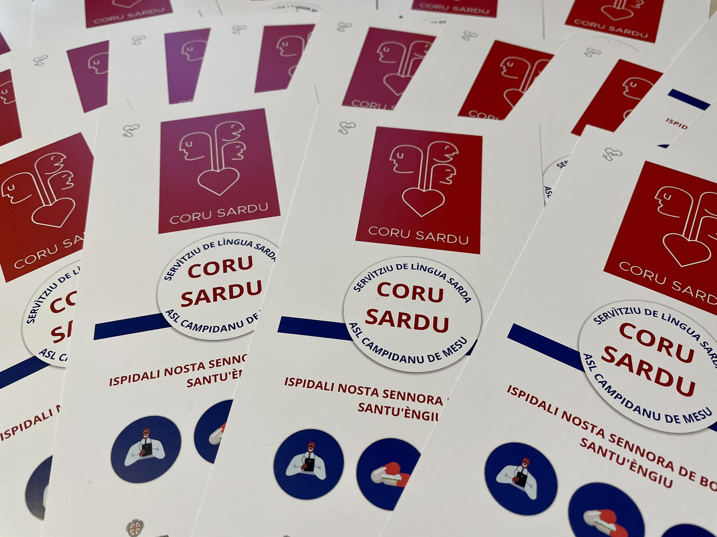
Unu coru chi fueddat sardu po is chi su sardu ddu tenint a coru
A heart that speaks Sardinian for those who care about the Sardinian language

Slide 8
Comenti est cuncordau su progetu ?
How is the project structured?
Su movidori est unu portalitu de lìngua sarda, abertu a is umperadoris, chi traballat pruschetotu cun su repartu de cardiologia ma agiudat is àterus repartus puru, cuncordendi fainas, aparicendi materialis chi pertocant is maladias (postus a disponimentu in su giassu internet de sa ASL puru), atobiendi is arricoveraus in repartu e is famìlias insoru, faendi furriaduras e donendi informatzionis
The core is a Sardinian language help desk. Open to users, that works with the cardiology department but also assist other departments by organizing activities, preparing materials related to diseases (which are also made available on the ASL website), meeting with hospitalized patients and their families, making translations and providing information

Slide 9
Comenti est cuncordau su progetu ?
How is the project structured?
Aìnturu de su progetu Coru sardu una parti manna dd’at tenta sa formatzioni de is operadoris sanitàrius chi ant pòtziu liai parti, a indonu, a duus livellus de cursu po s’impreu de su sardu in su traballu insoru. Est sa primu borta chi in Sardìnnia unu cursu de lìngua sarda donat is crèditus ECM ( Educazione continua in Medicina) po sa professioni
Within the project, an important role was played by the training of healthcare professionals, who were able to participate for free in two levels of courses on using Sardinian in their work. This is the first time in Sardinia that a Sardinian language course provides ECM credits (Continuing Medical Education) for the profession

Slide 10
Comenti est andau a innantis su progetu ?
How did the project continue?
Traballendi a su costau de is operadoris sanitàrius eus cumprèndiu chi fiaus pesendi una cuscièntzia noa in contu de lìngua sarda e chi s’ispidali fiat bessendi unu mundu piticu cun piessignus linguìsticus capassus de ddi donai una bisura beni assestada. Aici est nàscia sa bidei de cumpartziri custus piessignus a manera crara po lassai un’arrastu de profetu po totu is chi imbucant in custu mundu piticu
By working alongside healthcare providers, we realized a new awareness of the Sardinian language was emerging, and the hospital was becoming a microcosm with linguistic features giving it a distinct identity. This inspired us to share these traits clearly, leaving a useful trace for everyone who enters this microcosm

Slide 11
Comenti est andau a innantis su progetu ?
How did the project continue?
Aici eus cumentzau a pensai a s’ispidali comenti a una mapa innui inditai in sardu is nòminis de is servìtzius, de is ambulatòrius, de is fainas e innui fruniri, sèmpiri in sardu, totu su chi podit serbiri a is umperadoris de s’ispidali. Eus pensau a candu s’agatant in ispidali e a candu torrant a domu puru, a manera chi sa cosa no siat po de badas. Bieus calincuna de custas fainas:
So, we started to imagine the hospital as a map, with the names of services, clinics and activities labelled in Sardinian, providing everything that could be useful to hospital users, all in Sardinian. We thought about when they are in the hospital and when they go home, so that the impact is not temporary. Let us see some examples of this work:

Slide 12
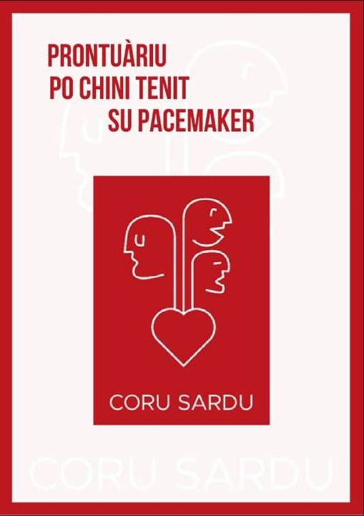
https://www.aslmediocampidano.it/wp-content/uploads/2023/01/Coru-sardu-Pacemaker-1.pdf

Slide 13
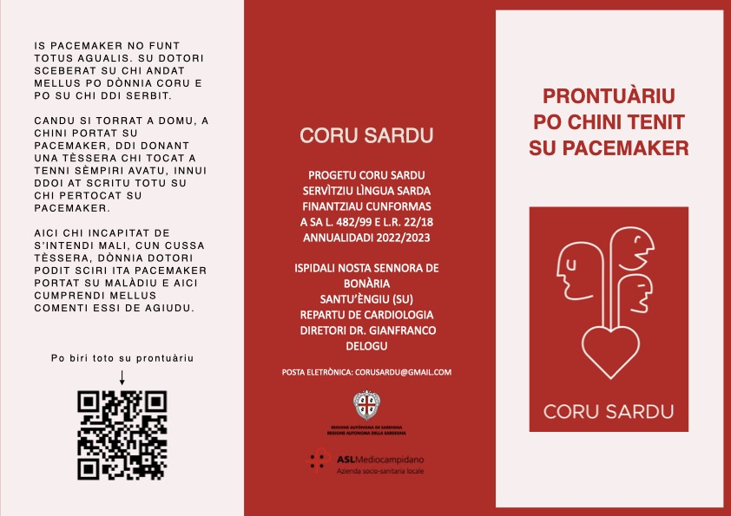
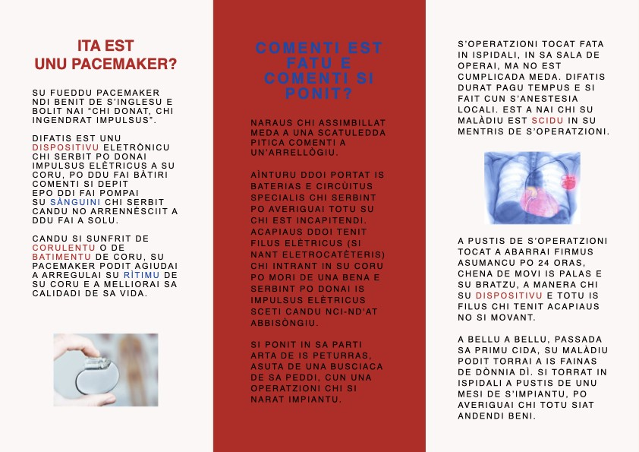

Slide 14
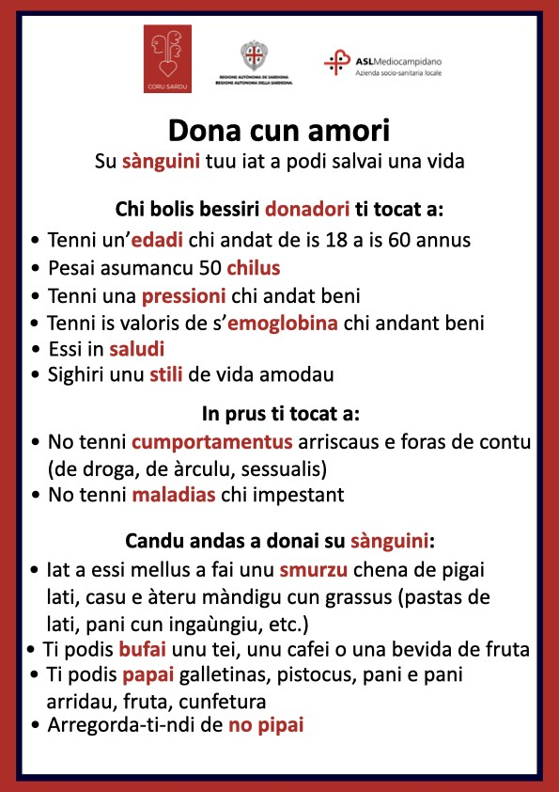

Slide 15
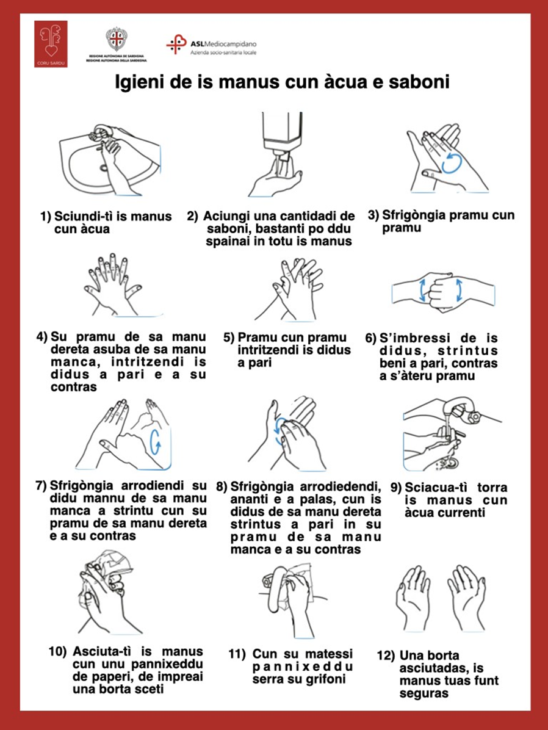

Slide 16
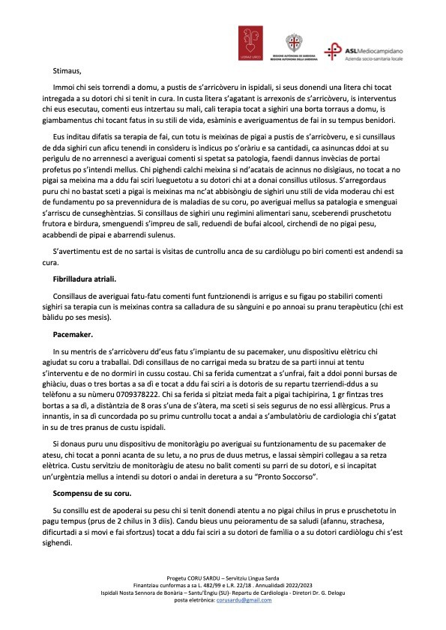

Slide 17
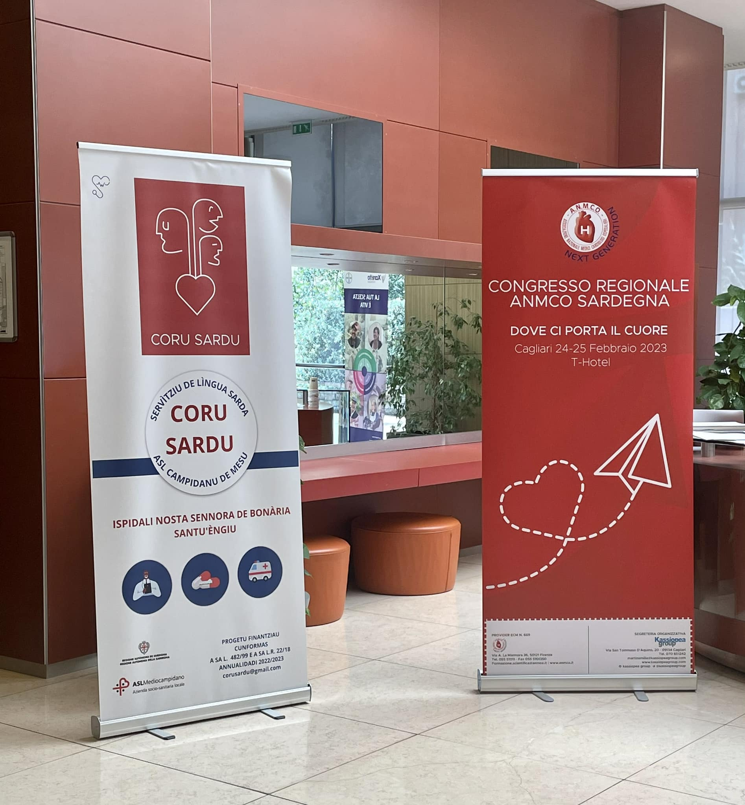
Intra de is àteras fainas eus biu chi is umperadoris ant agradèssiu meda cussas chi punnànt a fai connosci mellus is maladias e is diis dedicadas a sa prevenidura ca su portalitu at liau parti impari a is repartus a atòbius comenti Cardiologias Abertas e sa Open Week dedicadas a is maladias a su coru, sa Dì Internatzionali de su Mali caducu, sa Dì de sa Daibeta, o a arresurtaus comenti su primau po sa Telemedicina
Among other activities, we saw that users greatly appreciated those aimed at increasing awareness of diseases and prevention days. The language help desk participated alongside hospital departments in events like Open Cardiology Days and Open Week dedicated to heart diseases, as well as International Epilepsy Day, Diabetes Day, and achievements such as the Telemedicine leadership initiative

Slide 18
Ita arresurtaus eus lòmpiu?
What results have we achieved?
In su mentris de su progetu eus apariciau duus documentus cun preguntas po averiguai s’agradessimentu de is umperadoris. Unu prus generali e unu po biri chi su sardu scritu potzat essi de agiudu in unu ambienti chi fintzas a immoi fiat mescamenti italòfono
During the project, we prepared two questionnaires to evaluate user satisfaction. One questionnaire was more general, while the other aimed to understand whether written Sardinian could be helpful in an environment that has so far been predominantly Italian-speaking

Slide 19
Ita arresurtaus eus lòmpiu?
What results have we achieved?
Intra de 120 umperadoris (maladius e parentis) chi eus pigau in consideru:
81 ant nau chi ant agradèssiu meda su servìtziu
25 ant nau chi iat a podi essi de profetu
14 ant nau chi no serbit a nudda
Among the 120 users (patients and family members) we considered:
81 said they were very pleased with the service
25 said that it could be useful
14 said that it’s of no use

Slide 20
Ita arresurtaus eus lòmpiu?
What results have we achieved?
Intra de 120 umperadoris (maladius e parentis) chi eus pigau in consideru:
67 ant nau chi est de importu a biri is ìndicus scritus in sardu
34 ant nau chi serbit tempus po cumprendi beni su sardu scritu
19 ant nau chi no nci cumprendint meda si est scritu
Among the 120 users (patients and family members) we considered:
67 said that it’s important to see signs written in Sardinian
34 said it takes time to fully understand written Sardinian
19 said they didn’t understand much when it came to written Sardinian

Slide 21
Poita apu sceberau de s’ammostai pròpiu custus arresurtaus? Poita tocat a nai chi su tretu po su sardu scritu est ancora longu. Sa genti, siat L1 siat L2, tenit dificurtadis no tanti a cumprendi s’abbisòngiu de depi scriri su sardu po circai de ddu sarvai, cantu a cumprendi e acolli sa grafia de una lìngua chi ant sèmpiri connotu po essi fueddada. Custus progetus podint agiudai a ndi fai cumprendi s’importu ma a solus no bastant si ammancat un’annèstriu e un’imparu in scola.
E pruschetotu si ammancat àteras formas de landscape spratas me is logus nostus comenti acuntessit in àteras minorias linguìsticas. Perou si donniunu de nosu a su sardu ddu fait imbucai in su mundu piticu cosa sua, una spera dda teneus ancora… asumancu creu.
Why did I choose to show you these specific results? Because it's important to acknowledge that the path for the Sardinian language is still a long one. People, whether L1 or L2 speakers, struggle not so much with understanding the need to write Sardinian to help preserve it, but with accepting the written form of a language they've always known as spoken. These projects can help emphasize its importance, but they alone are not enough without education and teaching in schools. And especially if there are no other linguistic landscapes throughout our communities, as seen with other minority languages. However, if each of us introduces Sardinian into our own microcosm, there is still hope… at least, I believe so

Slide 22
Gràtzias meda po m’ai ascurtau
Thank you for listening to me
Manuela Ennas – Coru Sardu

